Slide 1
Intellitune
Automatic ham radio antenna tuner
Notes:
Preston

Slide 2




Team Members
Preston Peranich
Jonah Stevens
Haley Knable
Noah Ihediwa
Electrical Engineering
Team Lead
Electrical Engineering
Electrical Engineering
Electrical Engineering
Notes:
All

Slide 3

Faculty Advisor
Education/Qualification
BS, Electrical and Electronics Engineering, Bogazici University, 2003
MS, Electrical and computer Engineering, George Washington University, 2005
PhD, Electrical and Computer Engineering, George Washington University, 2009
Relevant Research and Interest
Microwave and Millimeter-wave Remote Sensing
RF Sensors and Systems
Antennas and Computational Electromagnetics
Dr. Mehmet Kurum
[1]
Notes:
Jonah

Slide 4
Team Member Roles
 | Hardware Design | Soldering Circuits | Software Design | Testing | Mounting | Integration
Preston |  |  | Lead |  |  | All
Jonah | Lead |  |  |  | Both | All
Haley |  | Lead |  |  | Both | All
Noah |  |  |  | Lead |  | All
Notes:
Jonah and Preston

Slide 5
Presentation Overview
Ham Radio Introduction
Problem and Solutions
Constraints
Technical
Practical
System Overview
System Testing
Timeline and Progress
Notes:
Jonah-20 secs

Slide 6
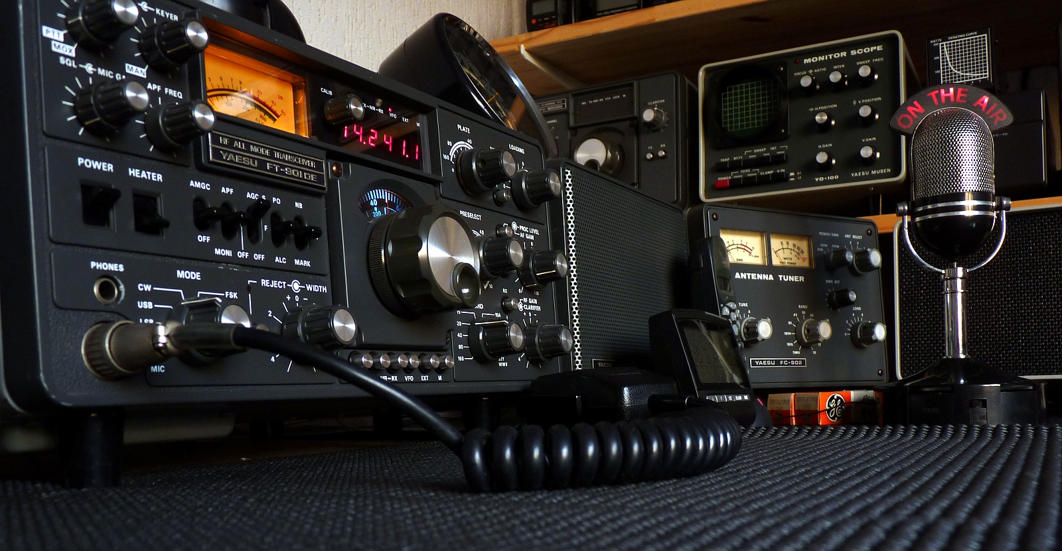
Ham Radio Introduction
[2]
Notes:
Haley - Ham radio is a hobby where operators communicate from radio to radio , without internet/cell phones. The most basic radio setup consists of a transceiver and an antenna. As the user changes the frequency that they are operating on, the antenna impedance changes, while the transceiver output impedance stays the same. However, in order to operate at maximum transmitted power it is essential that the antenna and and transceiver impedances match. 40 secs

Slide 7
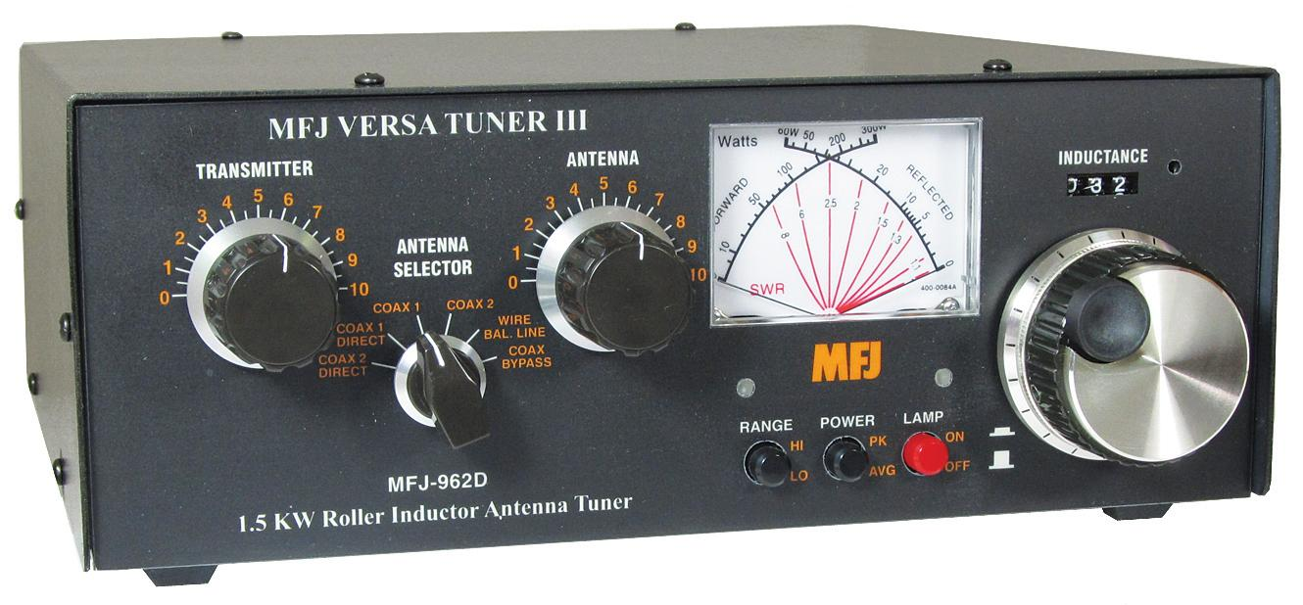
Problem
Manual tuning is time consuming and lacks precision.
Notes:
Noah

Slide 8
Solution
Intellitune will perform fast and reliable automatic tuning.
Notes:
Noah

Slide 9
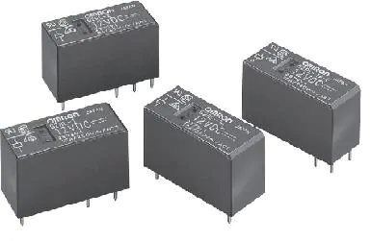
Problem
Discrete components leave room for lack of precision
Current automatic tuning units employ many relays that burn up over time
Notes:
Noah

Slide 10
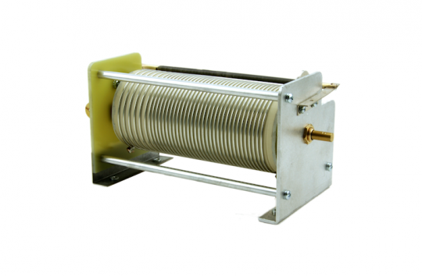
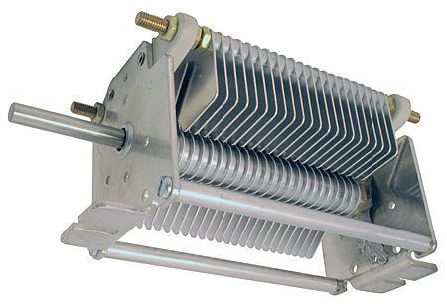
Solution
Intellitune utilizes variable components that can be adjusted to precise values of impedance
Design contains significantly less relays
Notes:
Noah-all problem and solution slides(51)

Slide 11
Technical Constraints
Name | Description
Power Rating | Handle 1.5 kW of power
Bandwidth | Pass through frequencies from 1.5 MHz to 30 MHz
VSWR Sensing | Determine the voltage standing wave ratio (VSWR) up to a 32:1 mismatch.
Frequency Sampling | Sample the transmitting signal and determine frequency up to 30 MHz
Impedance Matching | Provide a tuning network that can match impedances from 12-1600 ohms
Notes:
Jonah - Power Rating, Bandwidth, VSWR Sensing(30 s)
Noah - Frequency Sampling, Impedance(15 s)

Slide 12

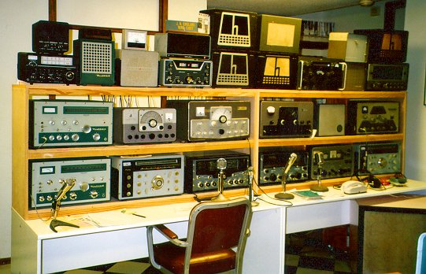
Practical Constraints
User Safety [4]
Product Size [5]
Notes:
Haley - (50 s) The two main practical constraints that need to be taken into consideration are user safety, and product size. User safety is critical for a product like intelletune that is capable of handling 1.5 kilowatts. The product must be manufactured with safety in mind so that the front panel , as well as the rest of the enclosure is safe to be touched.
Ensuring user safety is critical, so the auto tuner must not pose any potential risks to users during operation. The Intellitune may handle up to a 1.5 kW load, but this high load presents the risk of electrocution. The design must ensure that all potentially dangerous RF current is isolated from the enclosure surface. Therefore, the Intellitune must be placed in a durable yet lightweight enclosure that provides adequate grounding so surface charge does not accumulate.
The second constraint that must be kept in mind is the physical size of the enclosure. A ham radio operator typically has a work-bench, or desk, with many different modules that perform different tasks in their set up. The Intellitune must remain competitive be compact enough so that users do not avoid it due to being oversized. A safe constaint for Intellitune is to keep it within 2 inches either direction of a similar existing model that is 13x7x16

Slide 13
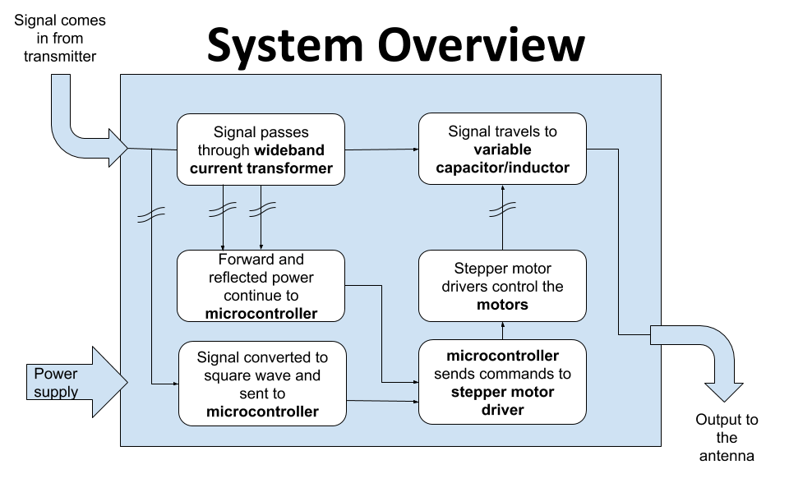
Notes:
Preston- 47

Slide 14
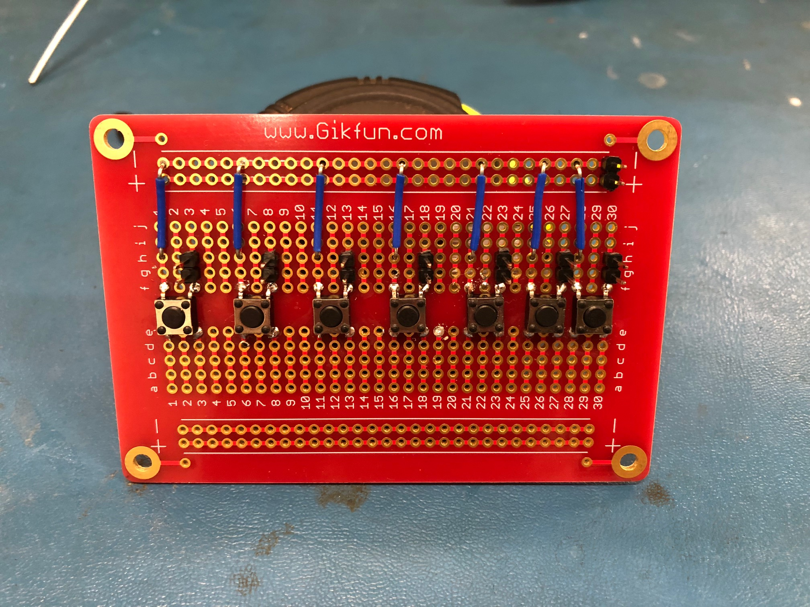
User Interface
7 functions triggered by pushbuttons
Display shows
SWR reading
Current tuning values
frequency
Test Procedure:
Pressed Buttons and monitored for correct output
Notes:
Jonah - features seven buttons triggered by a oush 22

Slide 15
Voltage Standing Wave Ratio (VSWR) Sensor
performed by the wideband current transformer
Test procedure:
Connect 50 ohm load to calibrate for 1.0 SWR
Test with varying known loads and and verify experimental reflection coefficient close to the theoretical value.
Monitor digital potentiometer to verify proper voltage scaling.
Notes:
Preston - 51

Slide 16
Frequency Sampling
Samples transmitted signal and measures frequency up to 30 Mhz
Test procedure: signals of various voltage and frequency are sent to the frequency counter, and its measurements are displayed on the LCD
Notes:
Noah - 30
One kHz precision

Slide 17
Stepper Motor Subsystem
needs to rotate variable components
Test Procedure:
Rotate motor without connection to components
Rotate motor with connection to components
Check final position of variable components against anticipated
Notes:
Haley - 30

Slide 18
Impedance Matching Code
Code that will calculate tuning network values
Test Procedure:
1: Input dummy reflection coefficients to verify algorithm calculations
2. Connect known dummy loads and verify correct load and SWR are calculated
3. Verify motors adjust to calculated tuning values
Notes:
Preston - 36

Slide 19
Variable Component Locating
Keep running track of component location
Testing Procedure:
Do manual calculations of what the location should be
Cross check that the potentiometer returns correct resistance that corresponds to the location
Notes:
Jonah - 46

Slide 20
Timeline
8/18
9/18
10/18
11/18
Initial Research
Design
Phase
Subsystem Development
Integration + Debug
Technology learned
Drew schematics and ordered components
Piecing together the subsystems
Finalizing the product
Notes:
Haley - 30

Slide 21
Progress
All subsystems have been completed
User interface
VSWR Sensing
Frequency counter
Variable component location sensing
Stepper motor subsystem
Impedance matching code
Notes:
Haley and Noah - 40

Slide 22
Future Work
Integration of Subsystems

Slide 23
References
[1] “Dr. Mehmet Kurum,” www.ecemsstate.edu, [Online] Available: http://www.ece.msstate.edu/people/faculty/dr-mehmet-kurum/. [Accessed: 1-Oct-2018].
[2] “Create a Spiral Dipole Antenna for a ham Radio,” formufit.com. [Online] Available: https://formufit.com/blogs/news/create-a-spiral-dipole-antenna-for-ham-radio. [Accessed: 1-Oct-2018].
[3] MFJ Enterprises, Inc., Starkville, MS, USA, “MFJ-998,” Available: https://www.mfjenterprises.com/Product.php?productid=MFJ-9982 . [Accessed: 18 Sep. 2018].
[4] “ISO Electrical Shock - Electrocution Warning Sign Symbol, SKU: IS-2026,” MySafetySign.com. [Online]. Available: https://www.mysafetysign.com/electrocution-symbol-triangle-warning-sign/sku-is-2026. [Accessed: 16-Oct-2018].
[5] “More Links,” WW2 Navy Radio - The Radioman's Job. [Online]. Available: http://www.virhistory.com/ham/ . [Accessed: 04-Oct-2018].
[6 ] “Back to Basics in Microwave Systems: Return Loss and VSWR,” commonscope.com. [Online]. Available: https://www.commscope.com/Blog/Back-to-Basics-in-Microwave-Systems-Return-Loss-and-VSWR/[Accessed: 04-Oct-2018].
[7] “Basics of Current Transformer,” engineeringtutorial.com. [Online]. Availiable: https://engineeringtutorial.com/basics-of-current-transformer/[Accessed: 04-Oct-2018].
[8] MFJ Enterprises Inc., Starkville, MS, USA, “Tuners, Antenna Tuners,” Available: http://www.mfjenterprises.com/Categories.php?sub=0&ref=5 . [Accessed: 30-Sep-2018].
[9] “296-50211-ND,” digkey.com. [Online]. Available: https://www.digikey.com/product-detail/en/texas-instruments/MSP-EXP430FR2355/296-50211-ND/9491427#images[Accessed: 04-Oct-2018].

Slide 24
References
[10] “Nema 23 Bipolar 1.8 degree 2.4Nm(340 oz.in) 1.8A 4.95V 57x57x104mm 4 wires,” stepperonline.com, 2018. [Online]. Available: https://www.omc-stepperonline.com/hybrid-stepper-motor/nema-23-bipolar-18deg-24nm-340ozin-18a-495v-57x57x104mm-4-wires-23hs41-1804s.html?mfp=149-step-angle%5B1.8%5D%2C145-holding-torque-ncm%5B190%2C220%2C240%2C250%2C280%2C283%2C300%2C310%2C340%2C400%2C450%2C707%2C850%2C1300%2C2200%2C3000%5D. [Accessed: 3-Oct-2018].
[11] “Nema 17 Stepper Motor Bipolar L=33mm w/ Gear Ratio 27:1 Planetary Gearbox,” stepperonline.com. [Online]. Available: https://www.omc-stepperonline.com/nema-17-stepper-motor-bipolar-l33mm-w-gear-raio-271-planetary-gearbox-17hs13-0404s-pg27.html. [Accessed: 3-Oct-2018].
[12] “Nema 11 Stepper Motor Bipolar L=51mm w/ Gear Ratio 100:1 Planetary Gearbox,” stepperonline.com, 2018. [Online] Available: https://www.omc-stepperonline.com/geared-stepper-motor/nema-11-stepper-motor-bipolar-l51mm-w-gear-raio-1001-planetary-gearbox-11hs20-0674s-pg100.html. [Accessed: 4-Oct-2018].
[13] “1460-1078-ND,” digikey.com. [Online]. Available: https://www.digikey.com/product-detail/en/trinamic-motion-control-gmbh/QSH5718-51-28-101/1460-1078-ND/4843429. [Accessed: 3-Oct-2018].
[14] “Big Easy Driver”, sparkfun.com, 2018. [Online] Available: https://www.sparkfun.com/products/12859. [Accessed: 16-Oct-2018].
[15] “EasyDriver - Stepper Motor Driver”, sparkfun.com, [Online] Available: https://www.sparkfun.com/products/12779. [Accessed: 6-Oct-2018].
[16] “Adafruit Motor/Stepper/Servo Shield for Arduino v2 Kit - v2.3,” adafruit.com, [Online]. Available: https://www.adafruit.com/product/1438. [Accessed: 5-Oct-2018].
[17] “1460-1159-ND,” digikey.com, [Online]. Available: https://www.digikey.com/product-detail/en/trinamic-motion-control-gmbh/TMC%2520SILENTSTEPSTICK/1460-1159-ND/5724190?WT.srch=1&gclid=EAIaIQobChMIk8-Ou5T63QIVCJyzCh0TjgHkEAYYASABEgKAzfD_BwE. [Accessed: 4-Oct-2018].

Slide 25
References
[18] “Steel versus Aluminum Weight, Strength, Cost, Malleability Comparison,” wenxelmetalspinning.com. [Online]. Available: https://www.wenzelmetalspinning.com/steel-vs-aluminum.html. [Accessed: 3-Oct-2018].
[19] “10 DIFFERENCES BETWEEN ALUMINUM AND STAINLESS STEEL,” metalsupermarkets.com. [Online]. Available: https://www.metalsupermarkets.com/10-differences-aluminum-stainless-steel/. [Accessed: 2-Oct-2018].
[20] “Weights of Various Metals in Pounds Per *Cubic Foot,” coyotesteel.com. [Online]. Available: http://www.coyotesteel.com/assets/img/PDFs/weightspercubicfoot.pdf. [Accessed: 4-Oct-2018].
[21] “Aluminum Prices and Aluminum Price Charts,” infomine.com. [Online]. Available:
http://www.infomine.com/investment/metal-prices/aluminum/. [Accessed: 7-Oct-2018].
[22] “Stainless Steel,” agmetalminer.com. [Online]. Available: https://agmetalminer.com/metal-prices/stainless-steel/. [Accessed: 8-Oct-2018].

Slide 26
Intellitune
Automatic ham radio antenna tuner

